Slide 1
Security Operations Center: Tools and Processes
Incident Response Day 2

Slide 2
Class Objectives
By the end of class today, students will be able to:
Articulate the uses of SIEMs and SOARs and explain their distinguishments
Use Wireshark go investigate pcap files.
Describe the process of investigating an incident.

Slide 3
SIEMs, SOARs, and VMs

Slide 4
SIEMS
Last class, we covered:
Incident Response
IR Plan and Playbook Creation
The Basics of an SOC
Planning an SOC

Slide 5

The Importance of Virtual Machines
The first resource in an Analyst’s toolbox is a virtual machine.
Virtual Machines provide analysts with a platform to view malware, malicious links, or other untrustworthy sources.
VMs act as a sandbox, making it difficult for harmful programs to escape and cause damage to the actual computer.
Virtual machines are not impervious to viruses,
but they are a good precaution as a layer of security.

Slide 6
We know SIEMs receive logs from a company’s systems, then output statuses and alerts...

Slide 7
SOARS
SOARS, the next generation of SIEMS...
SOARs are Security Orchestration, Automation, and Response systems that provide the same monitoring and alerts of SIEMS plus automation of some actions on behalf of an analyst.
Systems incorporate SOARS to automate security tasks across multiple systems, applications, and devices.
For example: SOARs may gather enrichment data like threat intelligence, or provide response actions like blocking an IP in a firewall or quarantining a system.
The more actions a SOARs automates, the sooner an analyst can get to work investigating the incident.

Slide 8

SOARS
System Data Backups
Firewall Logs
SOARs
Unix System Logs
IPS/IDS/HIDS
Proxy Server Logs
Automated Packet Captures for analysis
Window Server Logs
SOAR systems often use Python scripts to automate these processes.
Analysts that know Python are able to review and modify these scripts.

Slide 9
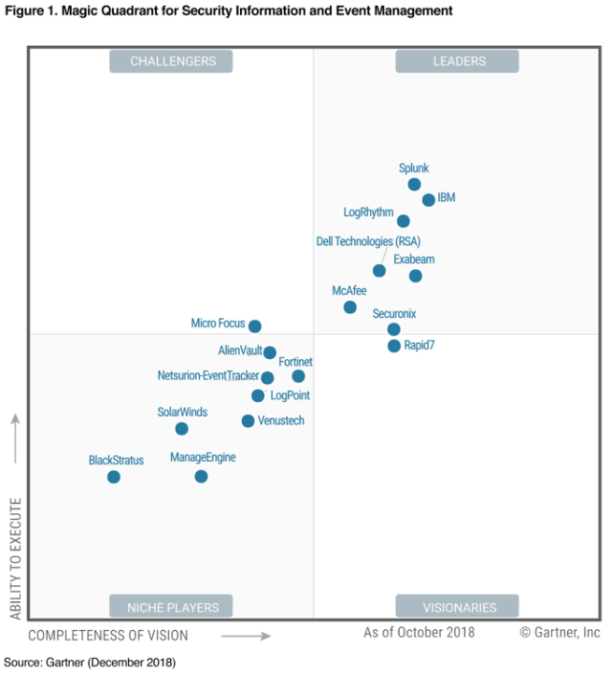
Many companies contribute to the vast SIEMs marketplace...

Slide 10
Wireshark Tips and Tricks

Slide 11
Wireshark Tips
Customizing and
Configuring Wireshark

Slide 12
Activity: Wireshark Tips and Tricks
In this activity, you will customize your Wireshark setup.
Instructions sent via Slack.
20 minutes

Slide 13
Wireshark Tips and Tricks

Slide 15
Incident Walkthrough
This exercise uses live malware.
Make sure you’re using your virtual machines!

Slide 16
Incident Walkthrough Demo
Questions we’ll answer as a group:
How can we confirm that a computer was infected with malware?
How can we identify the computers involved in the incident?
Can we identify when and how the computer was infected?
Can we identify source and destination IP addresses and ports used in the attack?
Can we identify the exact malware that was used in the attack?
Can we create a firewall rule to prevent this attack in the future?
Set-Up / Introduction
Intrusion Detection Alert File Inspection
Pcap Inspection
Post-Incident Report

Slide 17
Activity: Post-Wireshark Activity
In this activity, you will investigate a malware attack using a Snort alert file and network pcap.
Instructions sent via Slack

Slide 18
Wireshark Activity

